Slide 1
Final Presentation
Presented by: Hope Shackelford, Levi Sutton, Alissa Beckett, Alex Smejkal

Slide 2
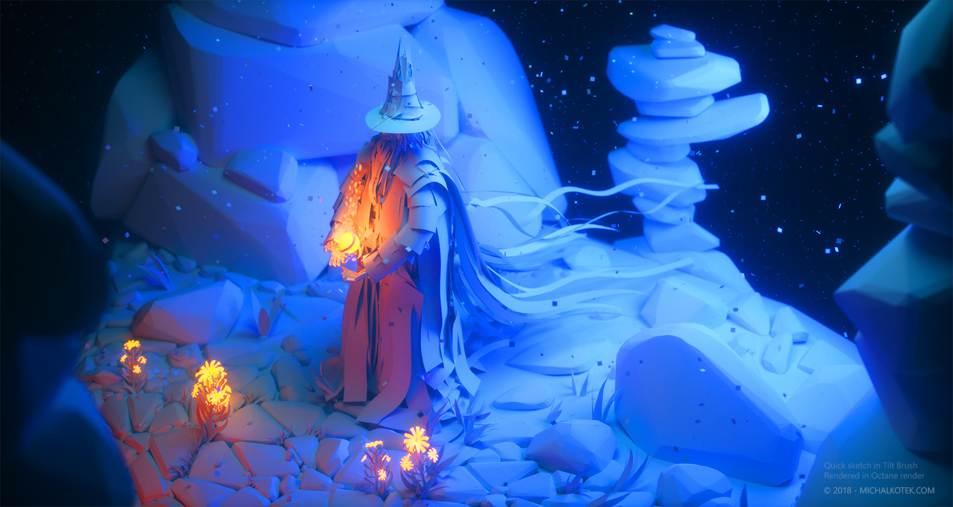
Abstract
The objective of this research project is to present the idea that an activity coloring book in the form of a virtual reality game will bring mental and physical benefits to art classes in the American public school system.
After aligning our project to meet our goals, we used a VR game called Tilt Brush to gain feedback on people’s thoughts of VR in the classroom.

Slide 3
Background Study
Arts Education in America: What the Declines Mean for Arts Participation
Finds that adults who have previously participated in arts education in their youth were more likely to have their future children participate in arts education as well
States that decrease in participation in the arts will equate to less funding and a continued decline in overall student participation
What we took away from this:
We think a great way to revamp the arts is to include more technology and to keep foundational art concepts, but update it to keep up with the times and technology.

Slide 4
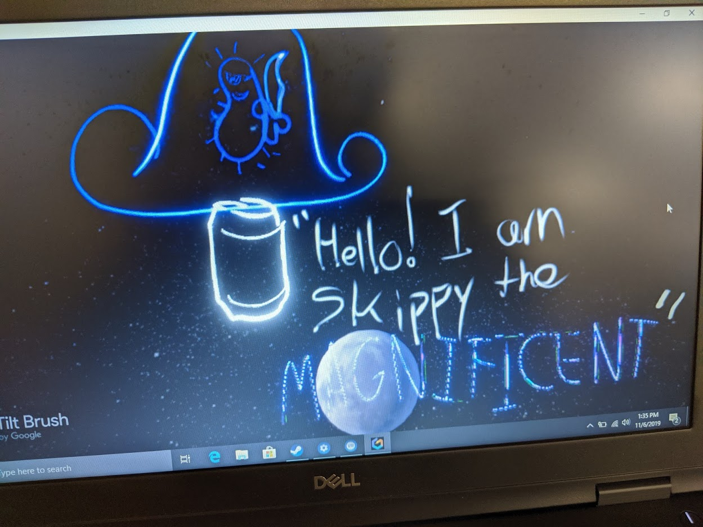
Methods of Research
We took a methodical approach to the second part of our research. We performed the following methods of research:
Watching people use VR games
Studying the effects of VR in a classroom setting
Obtained user’s feedback during testing on VR in an educational setting.

Slide 5
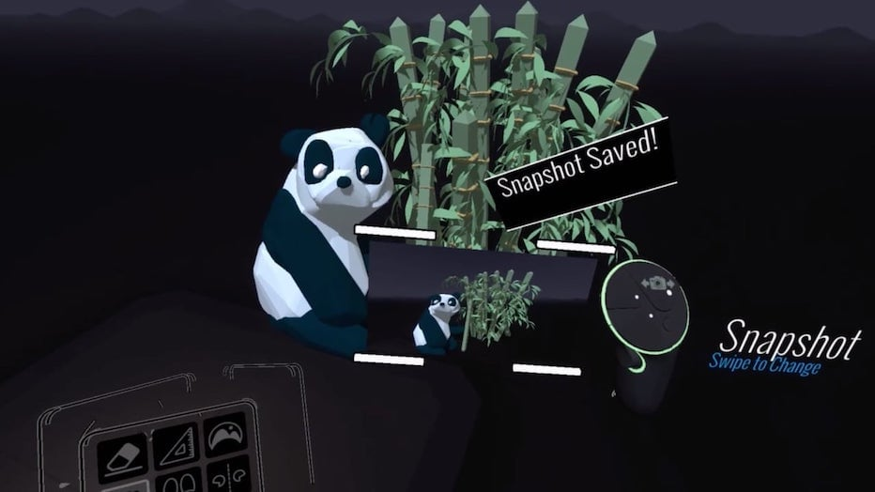
Feedback from live study Q#1
Question #1: How do you feel about vr in an educational setting?
“VR has the potential to give students a broader and more engaging experience into various subjects and interests.”
“I think VR could be a very useful tool in education.”
“I think VR could work well with online classes.”
“cool but it might be hard in low funded areas”

Slide 6
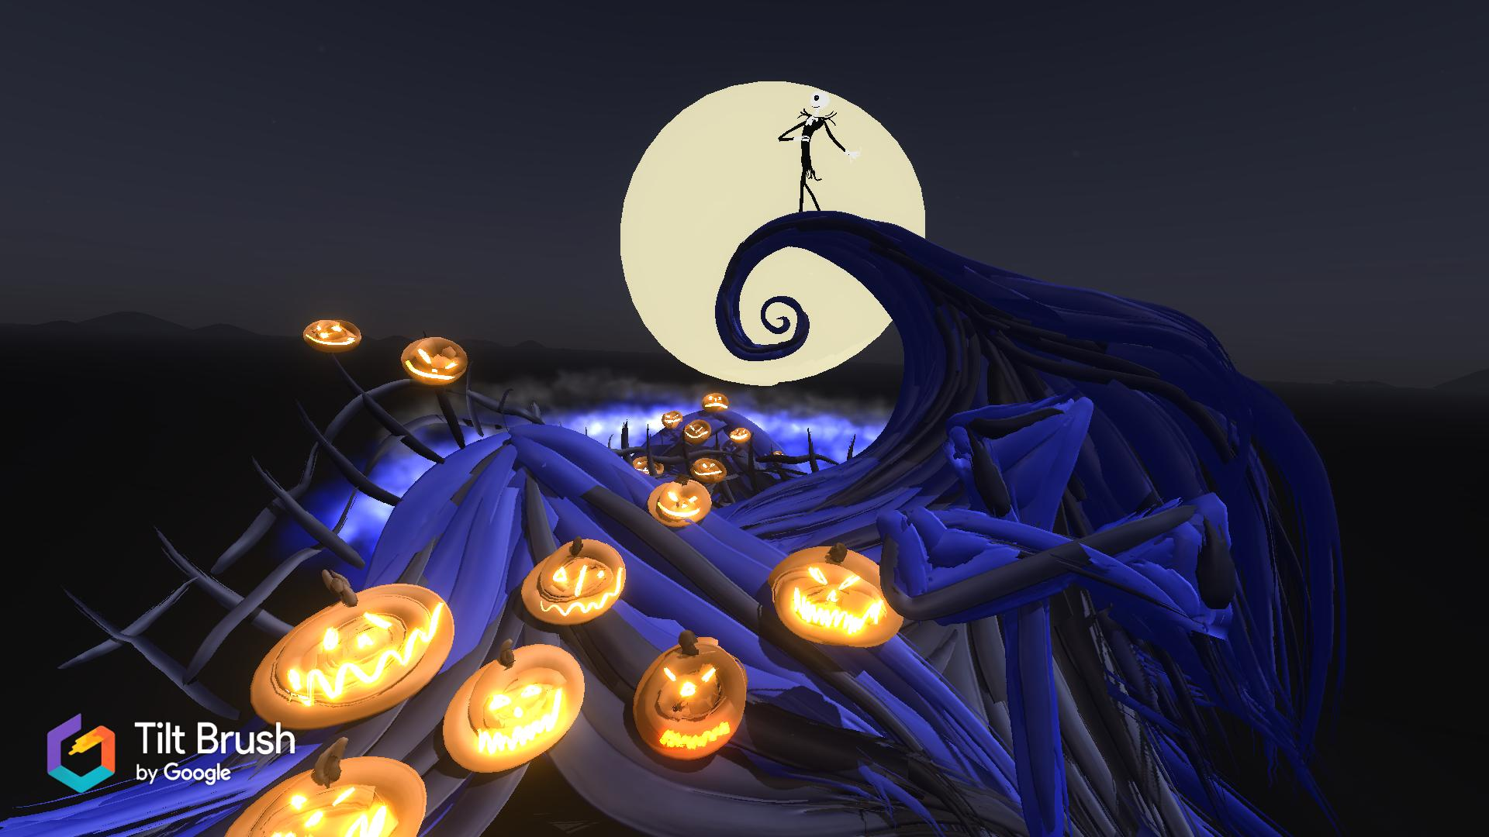
Feedback from live study Q#2
Question #2: Do you think vr could help revitalize the art education in america so there provides a better purpose to taking art courses?
“I think VR in art would bring art education to a more modern and useful application..”
“I think people could make very creative art using this and it's easily accessible as well.”

Slide 7



First drafts at creating icons for the VR game

Slide 8
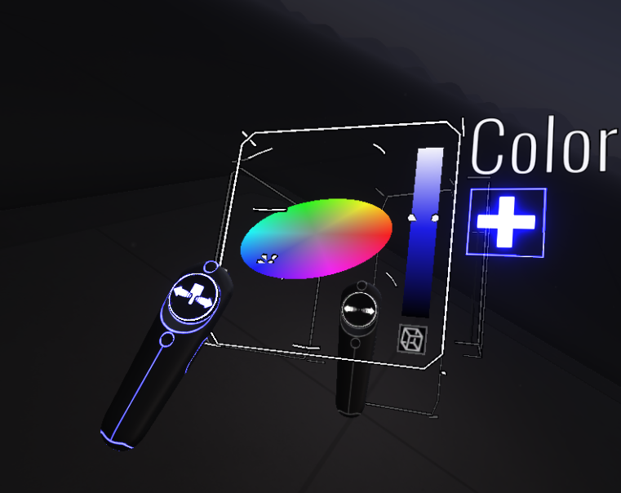
Closing thoughts...
In conclusion, we loved getting to research this concept and utilize the provided VR equipment.
This idea could better prepare students who plan to enter the arts industry by providing them with not only artistic but more technology adept skills.
Thank you Dr. North for allowing us to utilize the VR equipment to complete our project!

Slide 9
Resources Used
For research:
IBA Boston
National Center of Technology Innovation and Center for Implementing Technology in Education
Rabkin, Nick, and E. C. Hedberg
Arts Education in America: What the Declines Mean for Arts Participation
U.S. Department of Education
For the game:
Unity software
HTC Vive Technology
Tilt Brush by Google
Notes:
Picture Links:
https://imgur.com/gallery/n0KIAx6
https://www.tiltbrush.com/
https://arstechnica.com/gaming/2016/04/learning-how-to-vr-with-tilt-brush-htc-vives-killer-app/
https://www.artstation.com/artwork/0XYxQE

